Slide 1
CS 498
Virtual Reality
Design Processes
(For internal use only)
Set 5

Slide 2
User Interactions
The ideal interaction set
https://www.youtube.com/watch?v=FheQe8rflWQ&t=43s
The goal:
Natural & intuitive, gesture driven interface
Current state of interactions
https://www.youtube.com/watch?v=65u3W7wjXs0
The reality:
Limited input devices, limited range of motion, limited FOV, 2D interfaces in 3D

Slide 3
User Interactions Yasser Malaika (Valve)
Common Interactions are: Object interactions, system commands & navigation
VR related terminology for input devices Maps to
6 DOF (Degrees of Freedom): Within Reach
Pointing Reach & beyond
Hand Control Activation elements (buttons, swiping etc.)
Ambient Invocation: things like voice Indirect & infrequent
Subconscious (your location in space, direction, rotation, etc.) Background
Affordance: aspect of an object that hints at function
Abstract affordances are important in User Comfort
In a person’s mind abstract affordances will lose out to concrete affordances
The more real the look of an affordance the higher the user expectations
If a gesture has meaning it can override the kinematic issues

Slide 4
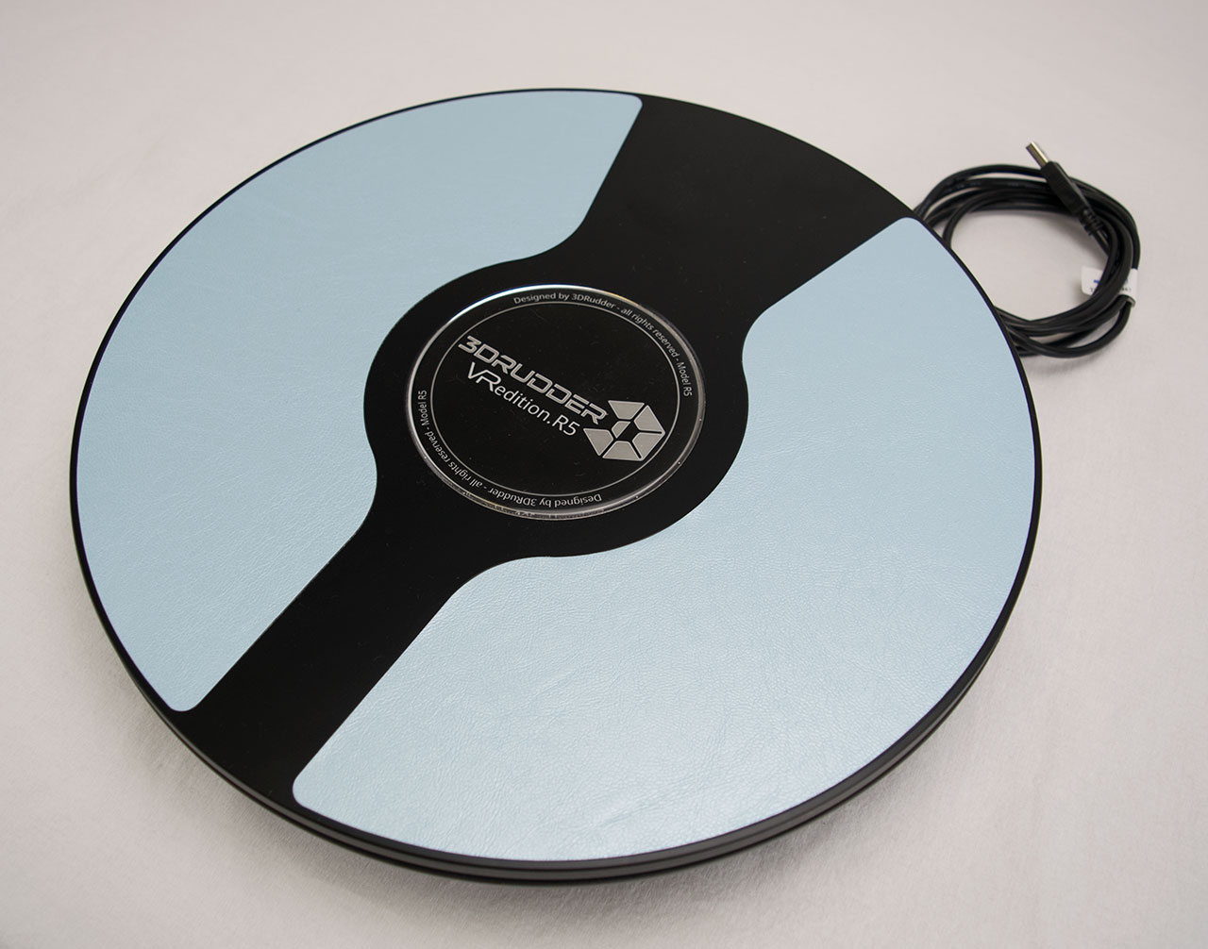
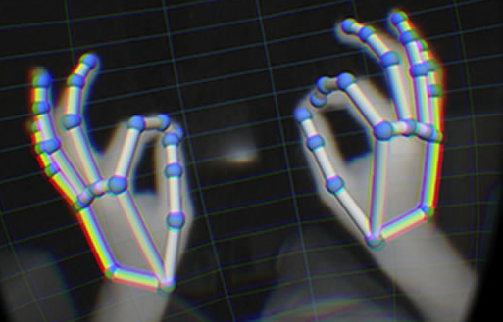
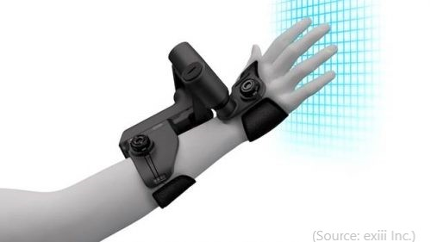
User Intent: Input and Feedback Yasser Malaika (Valve)
Input devices are fairly consistent through the Vive, Rift/Quest and PSVR
They offer 6 degrees of freedom and excellent 1 to 1 position tracking
Give developers advantages
Able to target multiple platforms
Set conventions that will develop into standards
Allows the development cultural to borrow from each other quickly
There are a multitude of other devices out there
Hand tracking
Haptic feedback via gloves, and other wearables
Foot devices
Voice command systems
Leap motion
3d rudder.com

Slide 5
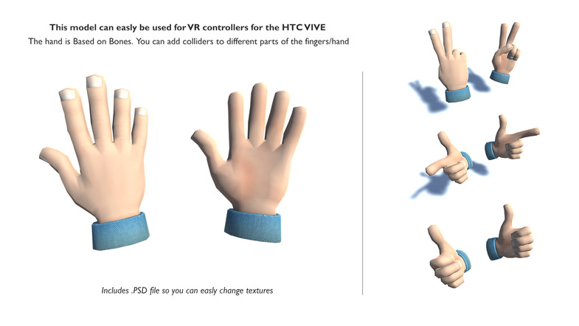


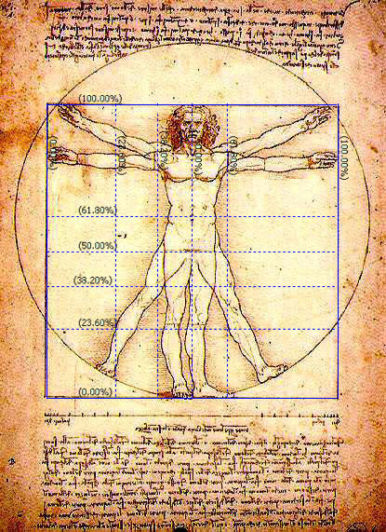
Object Interactions: Selection Yasser Malaika (Valve)
VR input systems map naturally to the human form
Visual (looking around) maps to the head
Movement maps to the legs
Selection/input maps to the arms/hands
Uncanny Valley: When things appear human but not quite, it creates a revulsion in the person.
In VR it actually applies to yourself
Hands are the best example of this
Don ‘t mix them up
Don’t use hands for movement
Head pointing/gaze for selection can be problematic
There are exceptions, teleportation for example
Technology is improving here
Unity Asset store
Renderhub.com

Slide 6
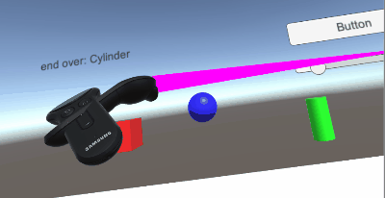
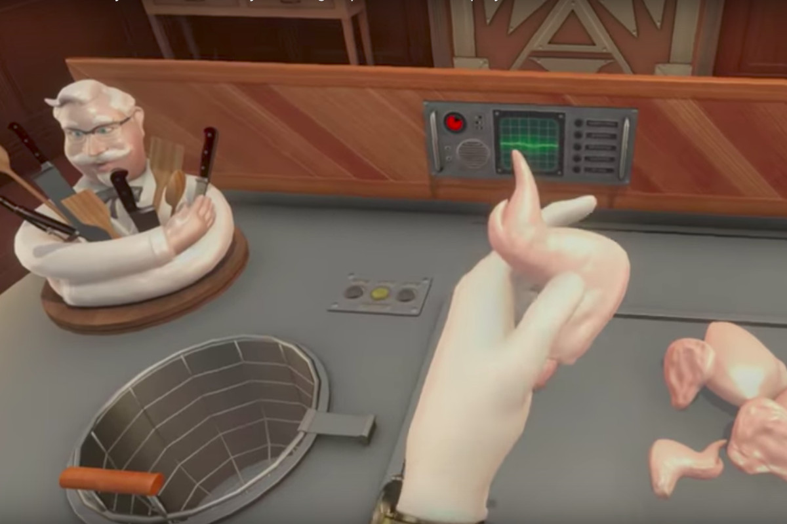
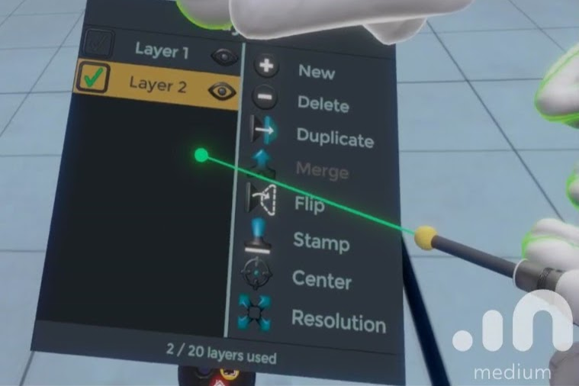
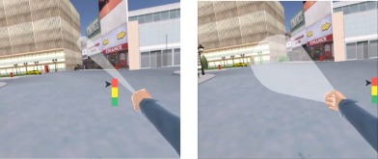
Object Interactions: Selection methodologies
Touching
Within reach (Local zone)
Hands are naturally mapped
You can also use a local pointer
Occlusion
Pretty much your standard 2D menu
Ray Cast (Mid/long range pointing)
Accurate method to choose
Variants include
Cone casting
Snap to (for teleportation)
Oculus developer forums
KFC
© 2017 Elsevier Ltd. All rights reserved.

Slide 7
Object Interactions: Selection methodologies
Arm Extentsion Selection
Go Go Technique
Non-linear mapping between physical and virtual hand position
Local and distant regions (linear < D, non-linear > D)
KFC
Poupyrev, I., Billinghurst, M., Weghorst, S., & Ichikawa, T. (1996). The Go-Go Interaction
Technique: Non-linear Mapping for Direct Manipulation in VR. Proceedings of the
ACM Symposium on User Interface Software and Technology, 79-80.
© 2017 Elsevier Ltd. All rights reserved.

Slide 8
Object Interaction: Considerations Leapmotion.com: design best practices
Interactive elements should be scaled to the expected interaction (e.g. full hand or finger/pointer size).
One finger/pointer targets should be no smaller than 20 mm in real-world size.
This ensures the user can accurately hit the target without accidentally triggering targets next to it.
Keep in mind that human hands naturally move in arcs, rather than straight lines.
Limit the number of gestures that users are required to learn.
All interactions should have a distinct initiation and completion state.
Ensure that users can interact with objects occluded by their hands.

Slide 9
Object Interactions: Selection Feedback
Feedback methods for selection available
Graphical Change
Voice
Color Change
Feedback method for selection made
Audio
Voice
Color Change
Graphic Change
Oculus developer forums

Slide 10
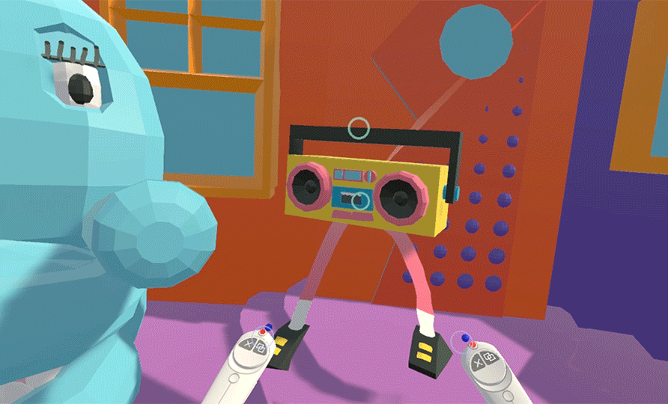
Object Interactions: Manipulation
Attachment, position, rotation, etc.
Examples: https://www.forrestthewoods.com/blog/the_vr_interface_of_dino_frontier/
Vrscout.com

Slide 11
VR Design Specifics: Examples
Hands:
Oculus’ Lone Echo’s https://www.youtube.com/watch?time_continue=42&v=CyP3LZNa_IA
Affordances:
Job Simulator: Gourmet Chef https://www.youtube.com/watch?v=qZX_WVhL3eg
KFC Job Training: 2:00 https://www.youtube.com/watch?v=LritONRSiXc

Slide 12
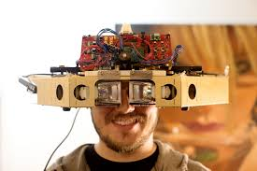
Augmented Reality Experiences
Window on the World (seen through a phone or tablet)
Passive
Adding elements to a photo
Active
Overlaying elements to the real world
Marker Driven
Non-Maker Driven
Immersive AR (seen through glasses or HMD)
Overlaid elements become part of the user’s reality
Copyright Magic Leap: Prototype Headset

Slide 13
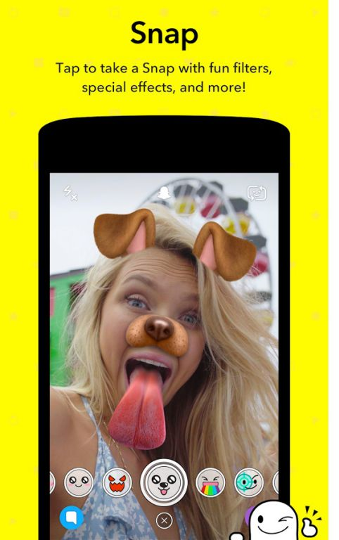
Augmented Reality UI: Passive WoW
Audience is likely mass market
UI should be very simple
Standard UI methods
Buttons
Swipes
Copyright Snap Inc.

Slide 14
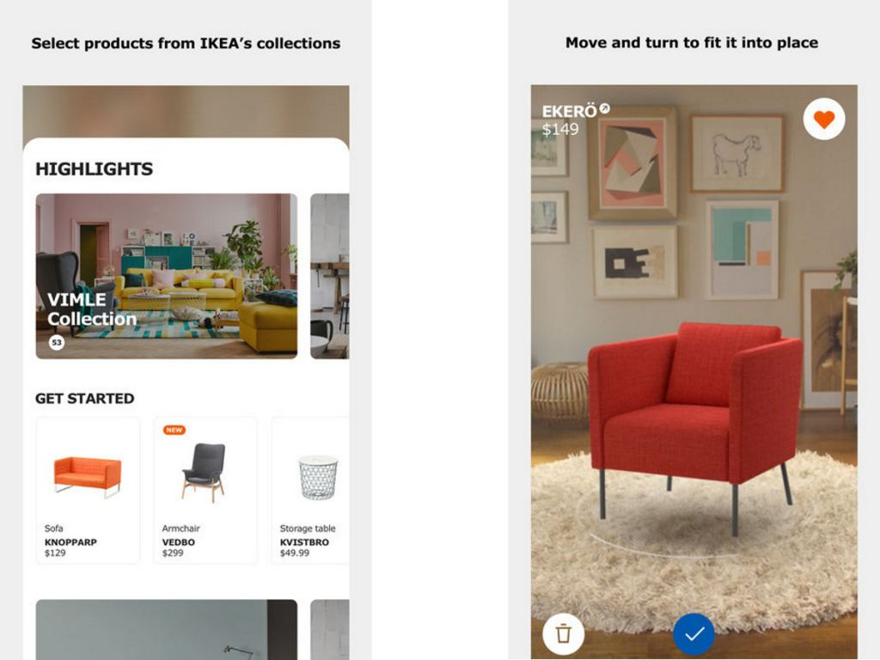
Augmented Reality UI: Active WoW
Audience is likely mass market
UI still needs to be very simple
Hide most of it, offer access to higher end users
Markers and surfaces
Consideration for space and marker placement
Standard UI methods
Buttons
Swipes
Consideration for Error Detection
Google’s path (Glasses to Lenses)
Copyright IKEA

Slide 15
Augmented Reality UI: Immersive
Very interesting opportunities
Interface options are similar to VR
Hardware makes a difference
Hand and/or Eye Tracking
Interface via device
Tilt Five https://www.kickstarter.com/projects/tiltfive/holographic-tabletop-gaming
Interface via visual/auditory feedback
Hololens 2 https://www.cnet.com/videos/watch-microsoft-demo-hololens-2-at-mwc/
3.55
Real World Tactile Feedback

Slide 16
Vision Canvas – Single Project/Level Version
Determine the Descriptors
Define the Genre
1st Person or 3rd, Travelogue, Shooter
Don’t include info about the world
Expectation is for standard Genre vernacular
Describe the World/Environment or IP
Information about the background of the world
Post Apocalyptic, Sci Fi, Japan, Beach , etc.
Licensed Intellectual Properties, etc.
Concepts
Narrative
These define the physical world, supplying context, interactions and connections. They describe how the user interacts (ex: camera view) and relates (especially for a existing IP).
High Level Vision Canvas
App/Game Name
Inspirations (note what it is inspiring) | Genre (ex: RPG, Travel) | Core Pillars (in the form “User can...") | Core Systems (ex: Save/Load, Combat) | User Experience (the emotion elicited)
 | IP/World (ex: Sci-fi, Beach)
 |  |  |  | User Types (rank by priority)

Slide 17
Genre (ex: 3rd Person)
The Genre describes, informs, and constrains the usage and camera style and sets expectations for the team what the team will be building for the User. These should be common genres
Don't put world descriptors here (Zombies are not a Genre, they are an element of the world, the genre would be Survival)
IP/World (high level descriptions)
The IP/World element is there to provide context for where the game/project is being placed. Elements about Narrative and environment belong here.
This is more important that most designers realize. Adding enough detail to describe the context of what you are building in just a few lines of text is key.
Timeframes matter (For example: Sci-fi tech. can vary greatly based on how far in the future we are talking about).

Slide 18
Vision Canvas – Single Project/Level Version
Descriptors, continued:
Write down all your inspirations
Get specific
UI
Game play features
Tone (Tone Targets)
Style (Graphic look)
Lighting
This helps define the emotional elements the user will be experiencing.
High Level Vision Canvas
App/Game Name
Inspirations (note what it is inspiring) | Genre (ex: RPG, Travel) | Core Pillars (in the form “User can...") | Core Systems (ex: Save/Load, Combat) | User Experience (the emotion elicited)
 | IP/World (ex: Sci-fi, Beach)
 |  |  |  | User Types (rank by priority)

Slide 19
Inspirations (note what is it inspiring)
Inspirations inform about what the usage/gameplay, tone (humor or atmosphere), UI, Audio, and art style are like by providing similar examples.
Inspirations are key, they show others what surrounds your idea and makes it special. Remember to note what part of the game each element inspires.

Slide 20
Vision Canvas – Single Project/Level Version
Target Information
User Experience
The emotional experience the user is having
Should relate to core pillars
Player Types
Self defined
Should be descriptive
Should represent the key player/purchasers
In descending order
Don’t go too broad
Make up your own descriptors
High Level Vision Canvas
App/Game Name
Inspirations (note what it is inspiring) | Genre (ex: RPG, Travel) | Core Pillars (in the form “User can...") | Core Systems (ex: Save/Load, Combat) | User Experience (the emotion elicited)
 | IP/World (ex: Sci-fi, Beach)
 |  |  |  | User Types (rank by priority)

Slide 21
User Experience (the emotion elicited)
The User experiences should be the foundation for your core mechanics (Core Pillars and Core Systems). They should be the emotional experiences you are trying to evoke from the user.
If you want to build something that has an impression on users, then you need to develop this element properly, with real consideration for experiences you have had as well as emotions you want to drive.
If you don't have much to offer here you may need to consider adding depth to what you are building (if it’s a tour say, you might want to gamify it in some way).
User Types (prioritized)
These are the types of users you think your project will attract. These should be prioritized by size of group (biggest first). This list helps you make decisions when conflicts arise between supporting features and handling scope.
We found that personalizing the Names for these groups helped describe them. Knowing these groups well helps define your efforts.
You don’t have to be one of these types, but you need to find these types to try your app to make sure it is meeting their needs.

Slide 22
Vision Canvas – Single Project/Level Version
Foundational Elements
Core Pillars
Features that drive the User Experience
In the form: “The User will …..”
Core Gameplay Systems
Systems that support the core pillars and other key aspects of the app/game
Points to key low level systems
Examples: Traversal, UI, AI (if needed).
High Level Vision Canvas
App/Game Name
Inspirations (note what it is inspiring) | Genre (ex: RPG, Travel) | Core Pillars (in the form “User can...") | Core Systems (ex: Save/Load, Combat) | User Experience (the emotion elicited)
 | IP/World (ex: Sci-fi, Beach)
 |  |  |  | User Types (rank by priority)

Slide 23
Core Pillars (in the form "User can...")
The core pillars are the actions the user can perform that define the user actions (the core mechanics) that, if removed would change the user experience.
Make sure each core pillar reflects/supports a user experience.
Grouping like elements or sub elements is good for clarity (ex: pillars about ranged and melee combat would fit under a more general combat pillar)
Don’t put emotions here, they belong in User Experiences. They can be rewritten as core pillars.

Slide 24
Core Systems (ex: Save/Load or Combat)
Core Systems are the key programmatic features/systems that need to be created to build your project, they should directly relate to Core Pillars and should also contain those systems needed that are not core but necessary (for example Save/Load)
Don't forget those background elements that drive key game play mechanics (AI, Audio, UI, etc.) These are key systems.
The details in this and core pillars drive the feature list. Be thoughtful here, start with higher level elements and then add contributing background elements).

